Slide 1
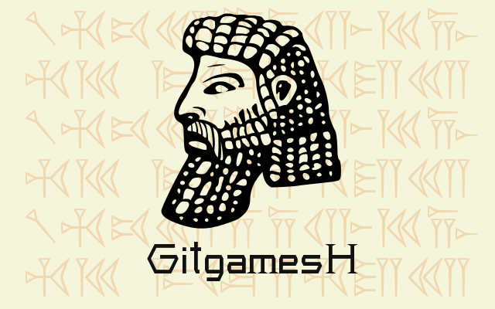

Slide 2



Why we did it?
  We love 3D printing and we love open source.
  Most of the existing webpages for the sharing of 3D models aren't open source.
  We want to allow users to keep track of their files and the changes that they make.
  We want to provide the benefits of using Git, but without it being technical.
  Supposedly there are over 10 million models available in GitHub already, but hard to find...
ΠWEEK - Jul2015

Slide 3
  The project is focused on the needs of the big opensource community that belongs to the 3D printing world.
  With some tweaks, this project can be extended to anyone who needs a git web manager for its own files
  and run it on a raspberry ...
ΠWEEK - Jul2015

Slide 4
Functionality
  Upload of binary and ascii STL files.
  Binaryfiles are converted to ascii before being pushed to Git
  Creation of new projects.
  Fork of other user projects.
  Upload and version control of new components.
  3D rendering of STL files.
  Download of files or automatically print them.
  Import/Fork 3D model from existing pages like Thingiverse or Github.
ΠWEEK - Jul2015

Slide 5
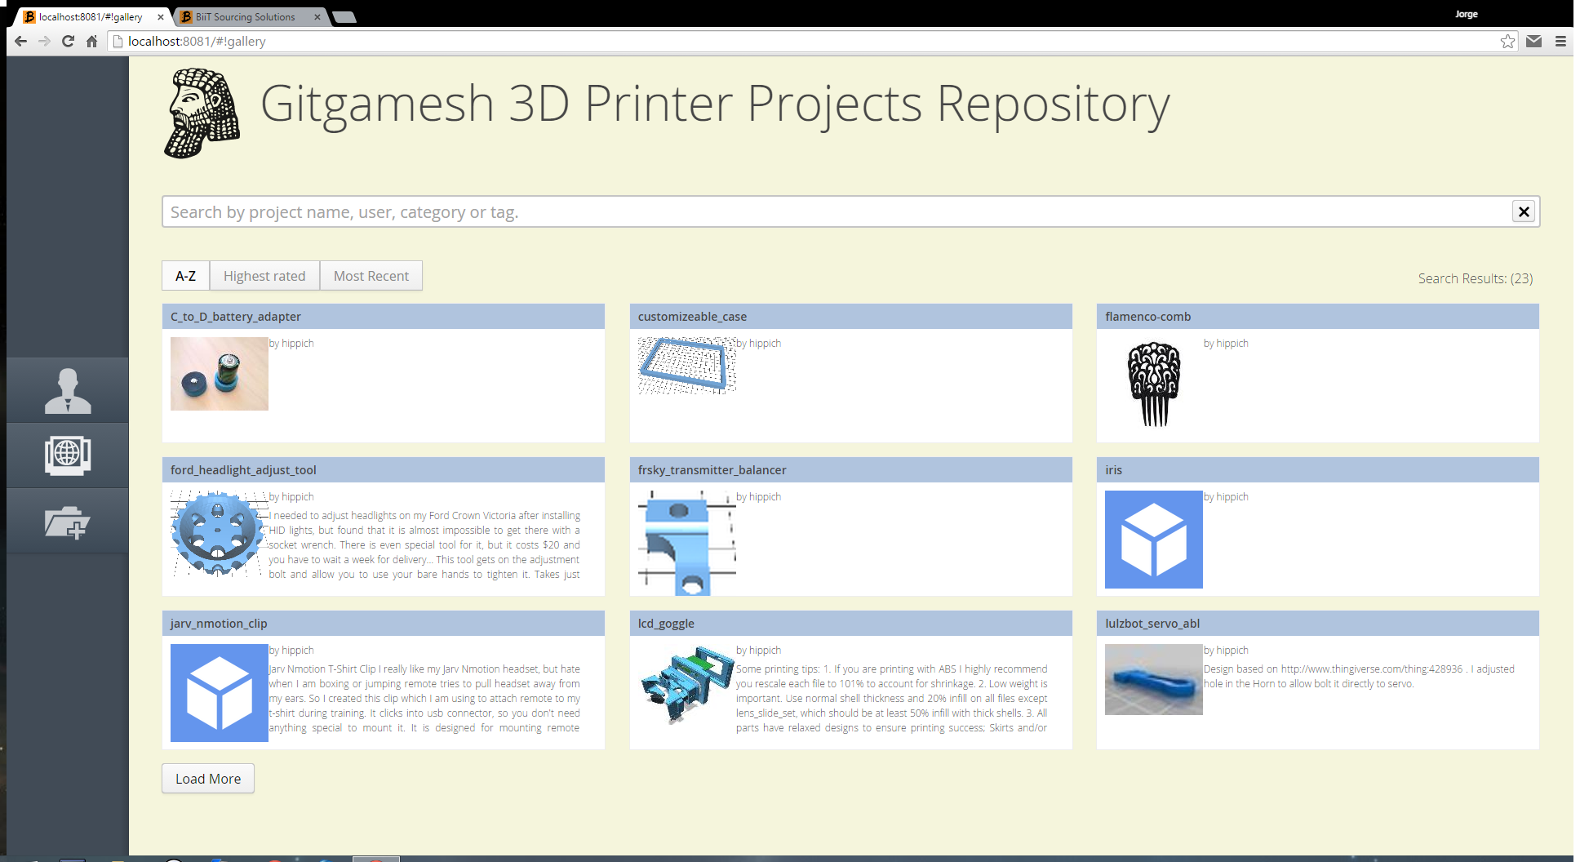
Gallery
ΠWEEK - Jul2015

Slide 6
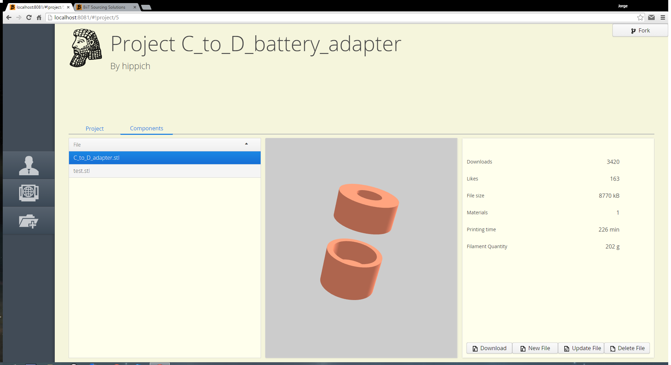
Project-view
ΠWEEK - Jul2015

Slide 7
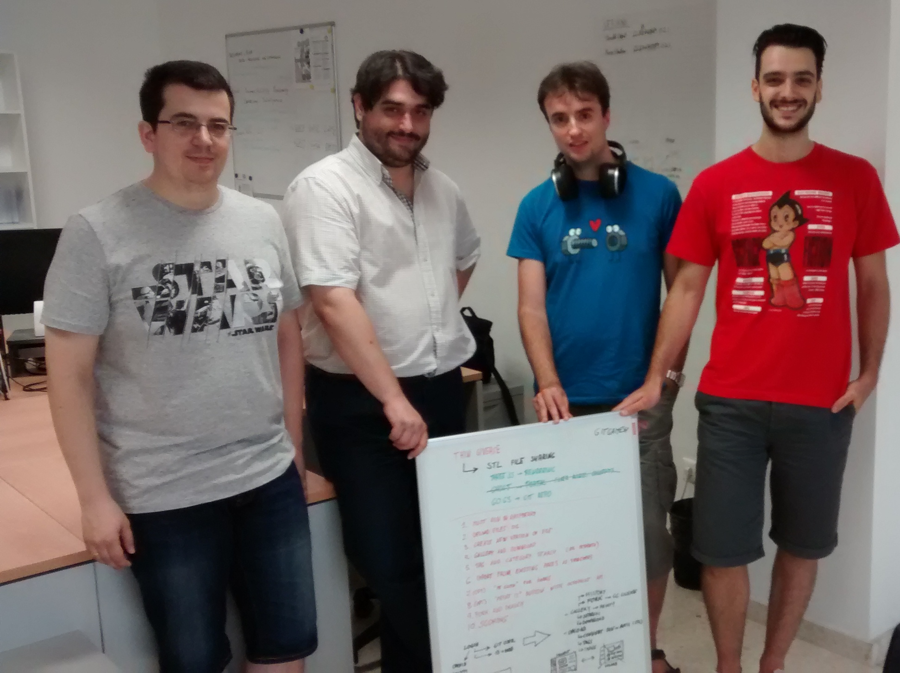
The team
ΠWEEK - Jul2015

Slide 8
Download
  Available for download at:
  https://github.com/a-perez/Gitgamesh
ΠWEEK - Jul2015

